Slide 1


Pressure Prediction by a Convolutional Neural Net
Jacob Child

Slide 2
The Need for Pressure
Flow visualization techniques are often centered around velocity fields
PIV, smoke, tufts, pathlines
It is often easier to collect velocity data than pressure data
Pressure helps to describe things like lift and vortices
Provides a more whole picture of the flow field

Slide 3
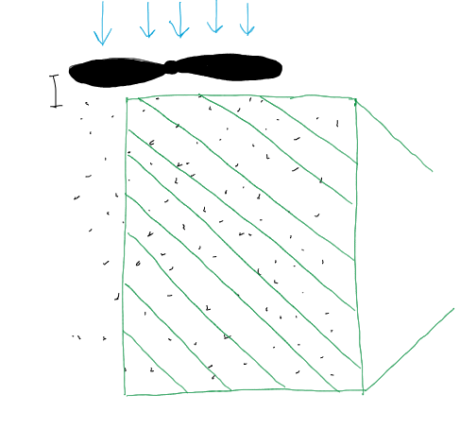
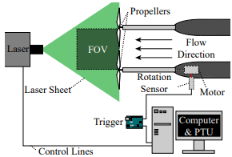

Particle Image Velocimetry
A laser sheet is shined through a particle laden flow
Two highspeed images are taken in quick succession
A computer is used to track the particle movement and create a velocity field
No pressure data
Used with permission

Slide 4
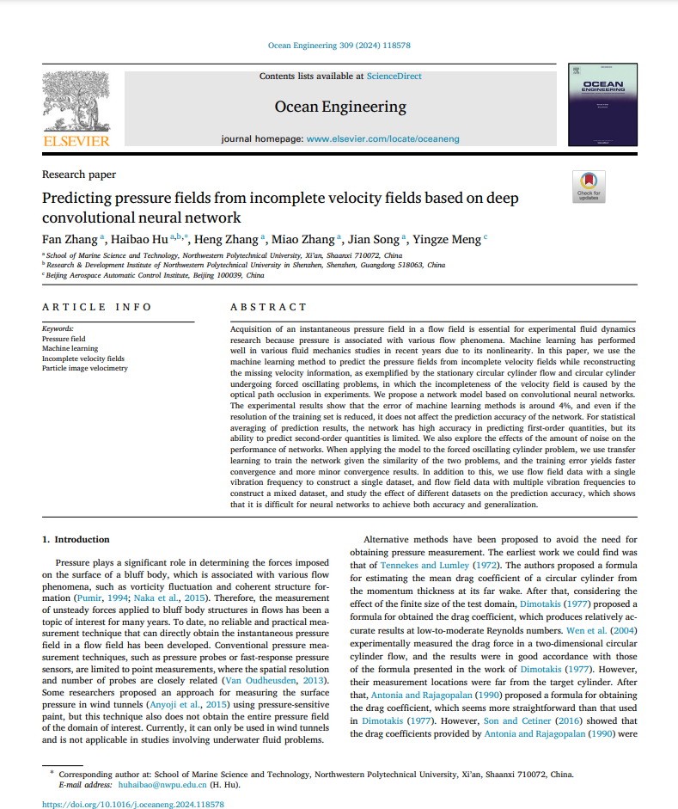
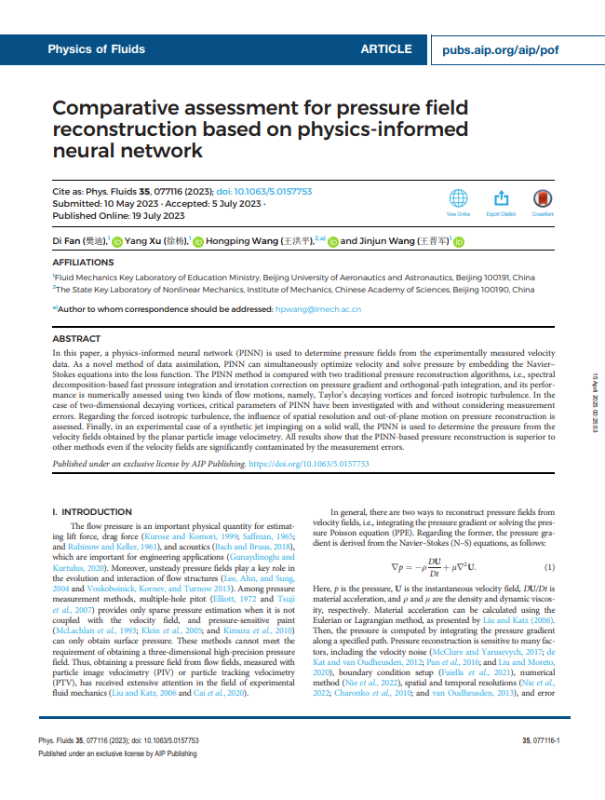



Relevant Literature
ResearchRabbit suggested paper collection (not curated)

Slide 5
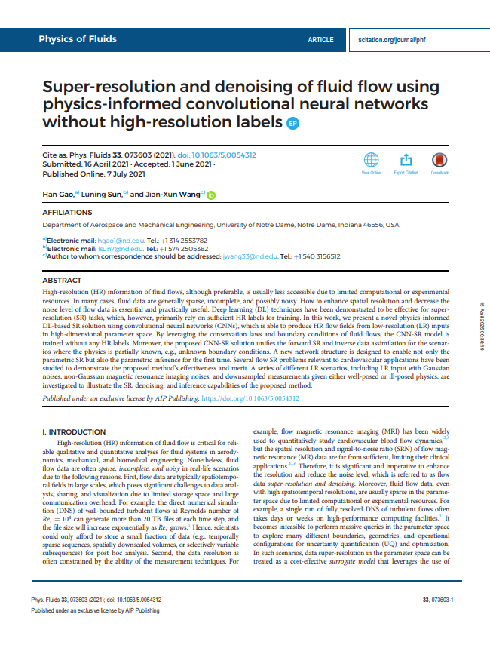

Approach: Vascular Flow (done in class)
Convolutional Neural Net to upscale x and y components of velocity, also predict a pressure field
Governing Equations: x and y momentum from 2D Navier-Stokes, continuity from 2D Navier Stokes
Incorrect pressure field
“The current framework cannot accurately recover the hidden pressure field because of the implicit coupling of pressure and velocity (i.e., the pressure appears as a source term in the momentum equations). The governing equation needs to be reformulated to strongly couple the pressure and velocity predictions based on, e.g., elliptic equation of pressure 81 and Rhie–Chow interpolation.75”

Slide 6
Methods
Convolutional Neural Net: Good for spatially correlated data (flow fields)
Activation Function: ReLU
Layer Channels: 2 (input) -> 16 -> 32 -> 64 -> 32 -> 3 (output)
Kernel Size: 5x5
Padding: 2
Learning Rate: 1e-3, or 1e-4
Copied and modified the paper slightly
produced satisfactory results

Slide 7
Layout
Super-resolution: upscale and predict u, v, p
Super-resolution: give the upscaled data and predict p
PIV Side-View Dataset: predict p
PIV Wake-View Dataset: predict p

Slide 8

Super-Resolution
Predicting: u, v, p
Enforced Boundary Conditions
Code

Slide 9
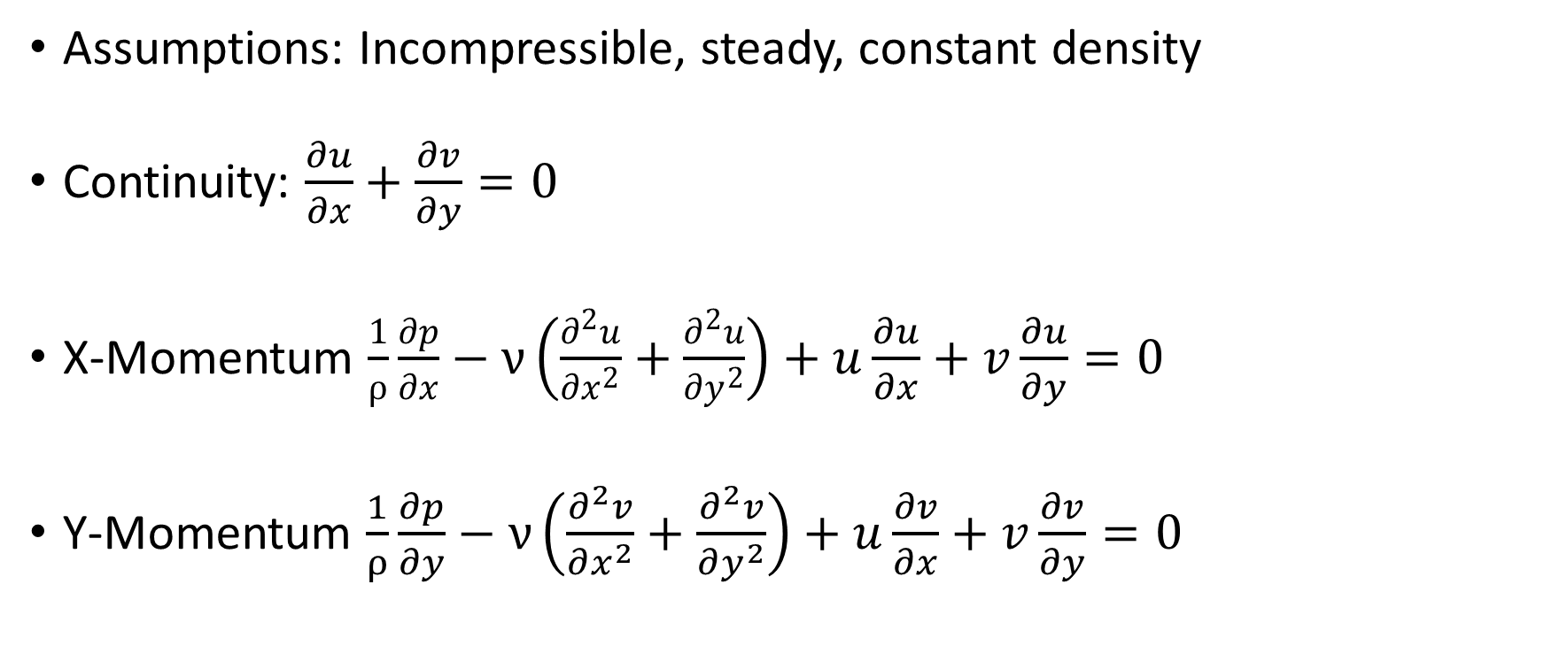
Loss Functions (Super-resolution for u, v, p)
Assumptions: Incompressible, steady, constant density
Continuity: $\frac{∂u}{∂x}+\frac{∂v}{∂y}=0$
X-Momentum $\frac{1}{ρ}\frac{∂p}{∂x}−ν\left(\frac{∂^{2}u}{∂x^{2}}+\frac{∂^{2}u}{∂y^{2}}\right)+u\frac{∂u}{∂x}+v\frac{∂u}{∂y}=0$
Y-Momentum $\frac{1}{ρ}\frac{∂p}{∂y}−ν\left(\frac{∂^{2}v}{∂x^{2}}+\frac{∂^{2}v}{∂y^{2}}\right)+u\frac{∂v}{∂x}+v\frac{∂v}{∂y}=0$

Slide 10
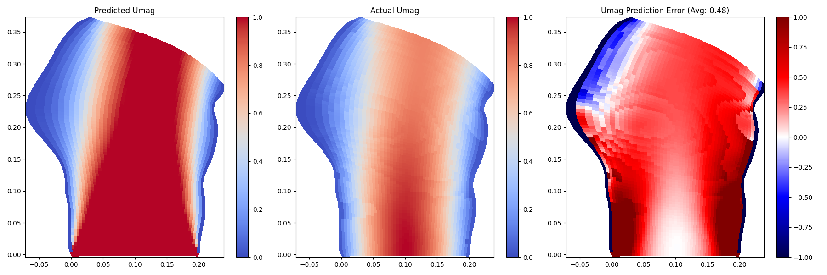
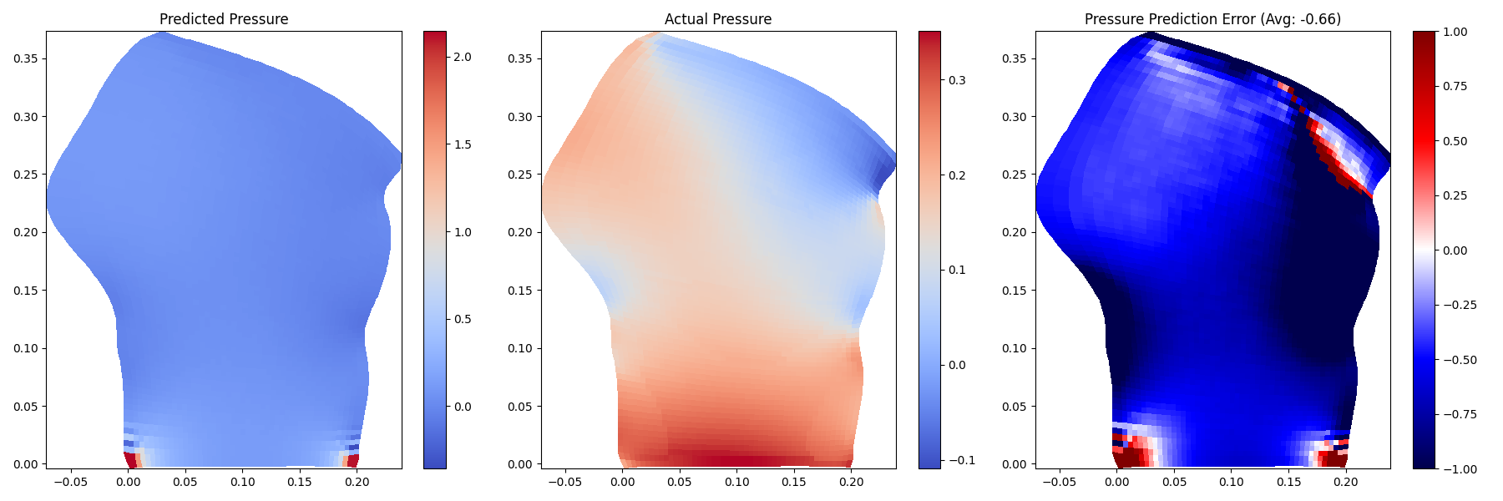
Results
Original, 5000 epochs, no extra pressure term

Slide 11


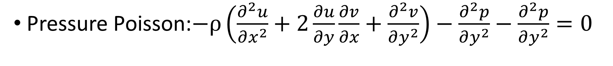
Pressure Poisson (Elliptic Equation of Pressure)
Pressure Poisson:$−ρ\left(\frac{∂^{2}u}{∂x^{2}}+2\frac{∂u}{∂y}\frac{∂v}{∂x}+\frac{∂^{2}v}{∂y^{2}}\right)−\frac{∂^{2}p}{∂y^{2}}−\frac{∂^{2}p}{∂y^{2}}=0$
Wikipedia: Pressure Poisson
Barba Group: Code Application

Slide 12
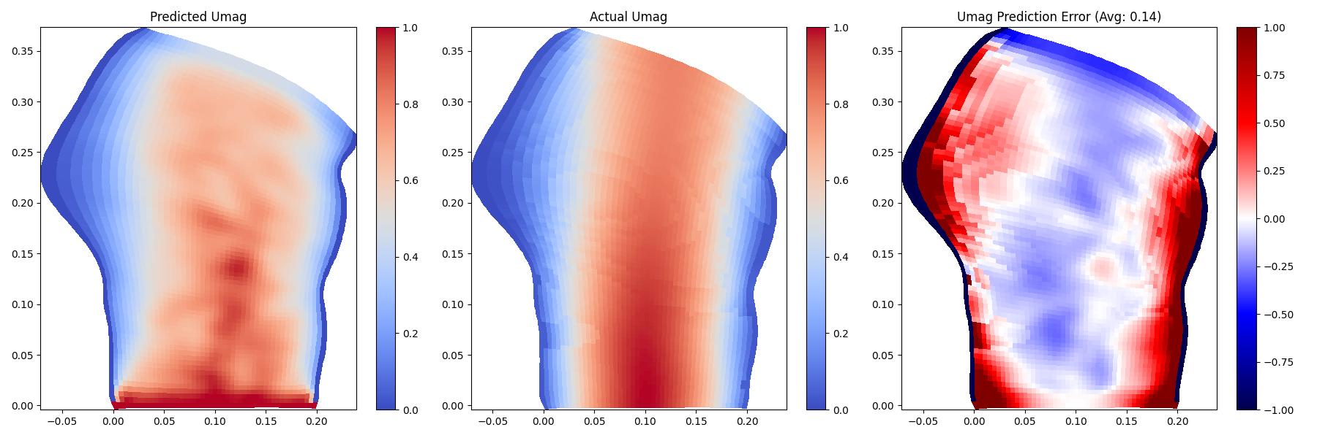
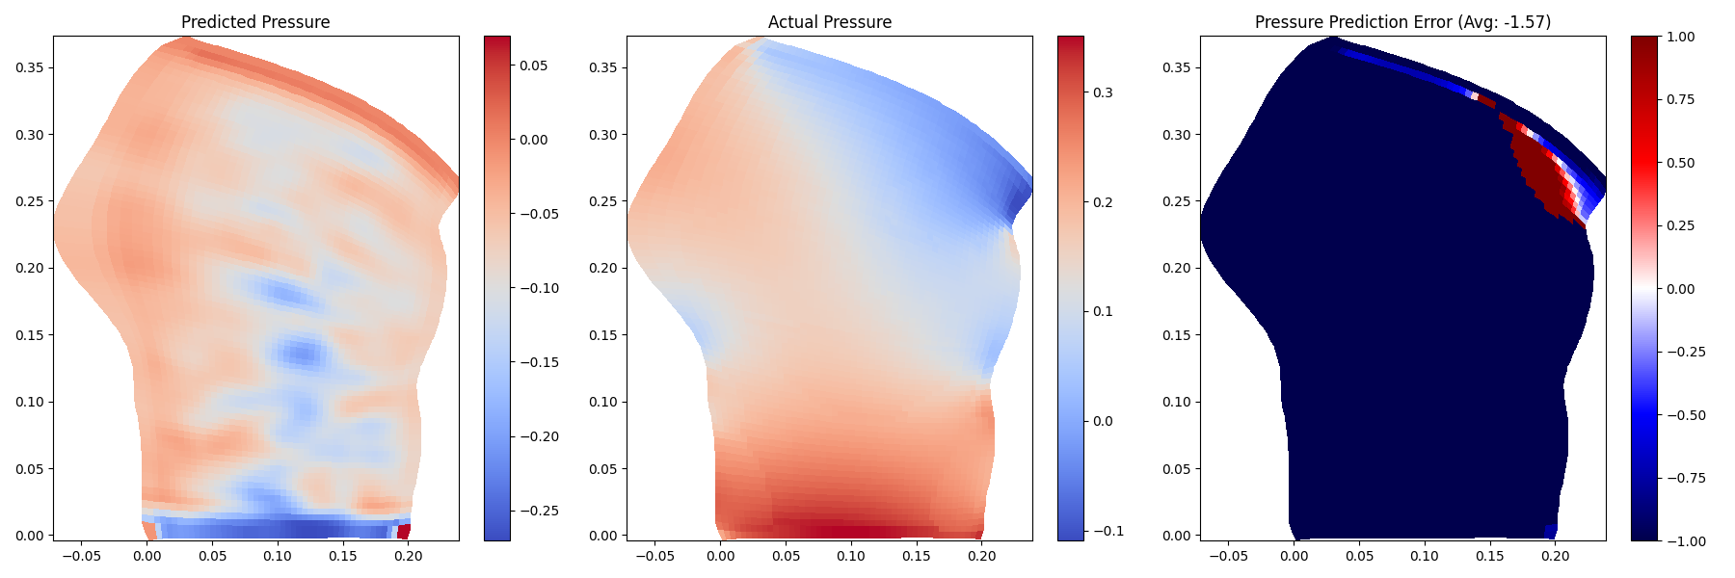
Results
Original, 10000 epochs, pressure poisson

Slide 13

Super-Resolution
Predicting: p
No Boundary Conditions
Code

Slide 14
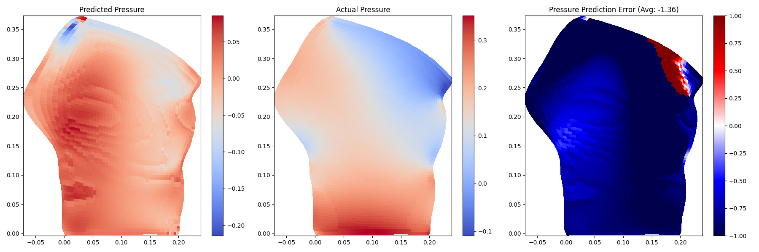
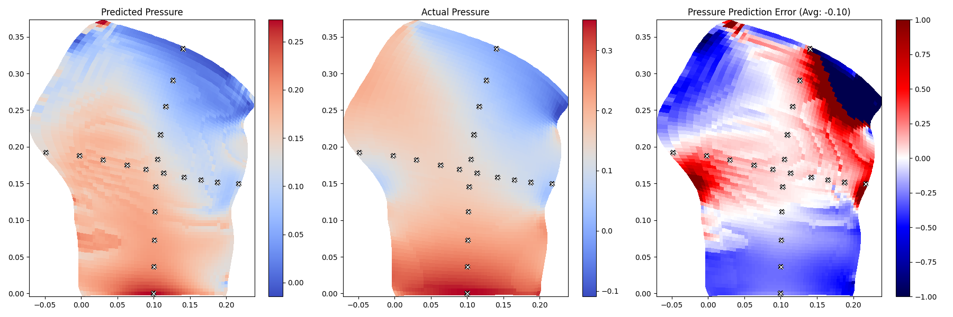
Results
5000 epochs, pressure poisson
5000 epochs, pressure poisson, “pitot data”

Slide 15
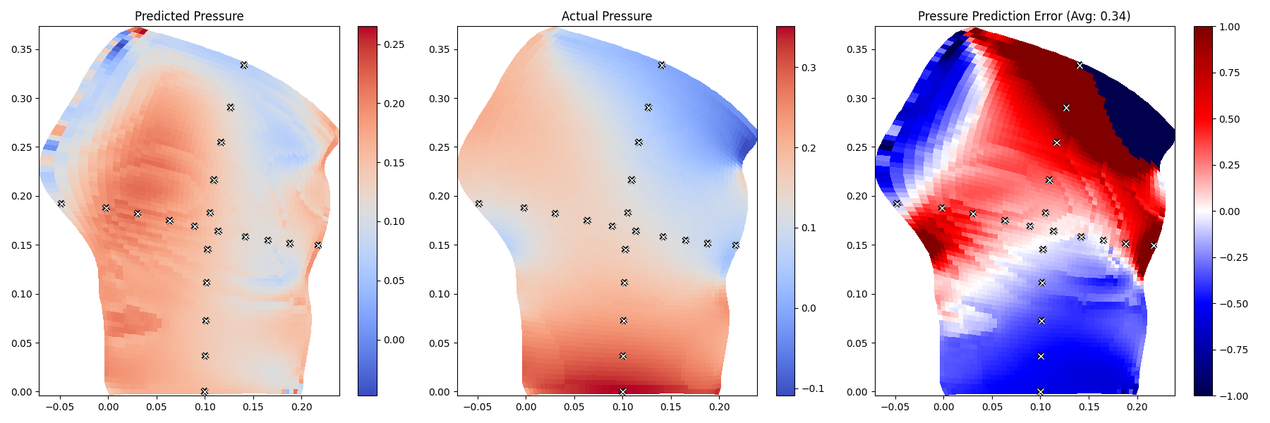
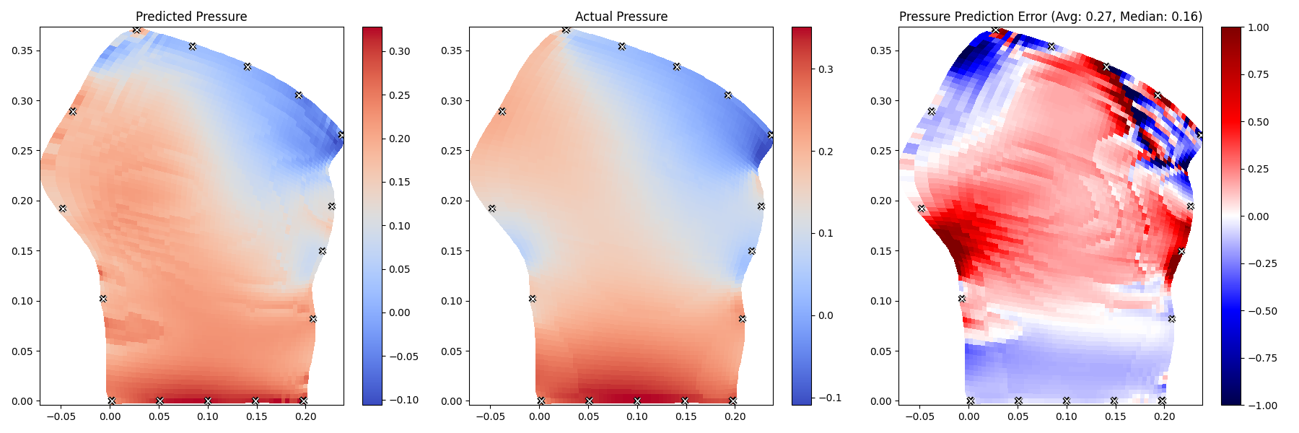
Results
10000 epochs, pressure poisson , “pitot data”
10000 epochs, pressure poisson, “pitot data” on the boundaries

Slide 16

PIV Side-View
Predicting: p
Code

Slide 17
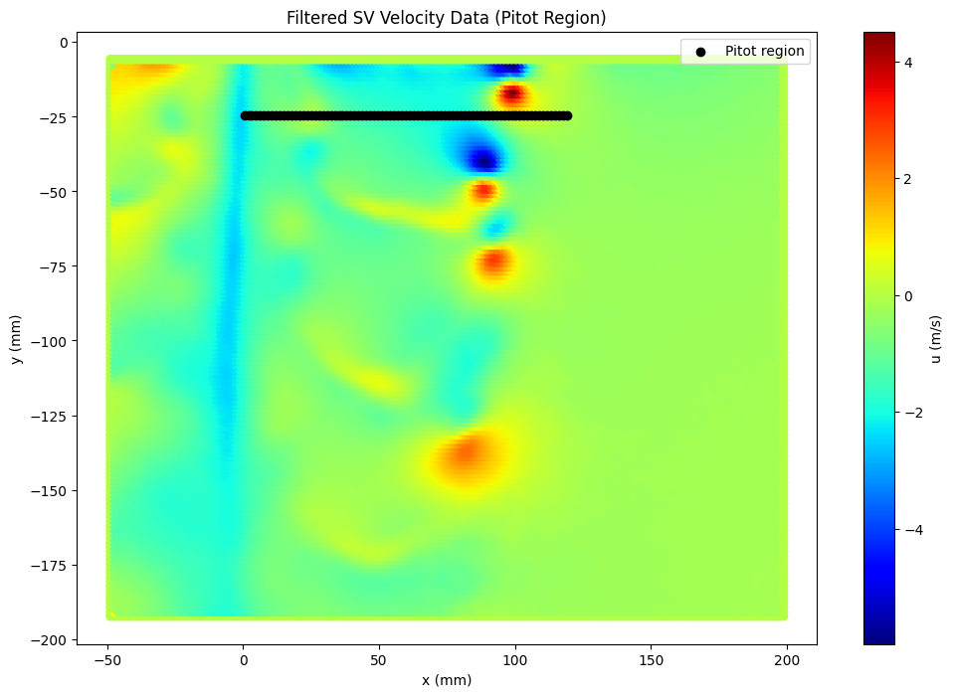
Input

Slide 18
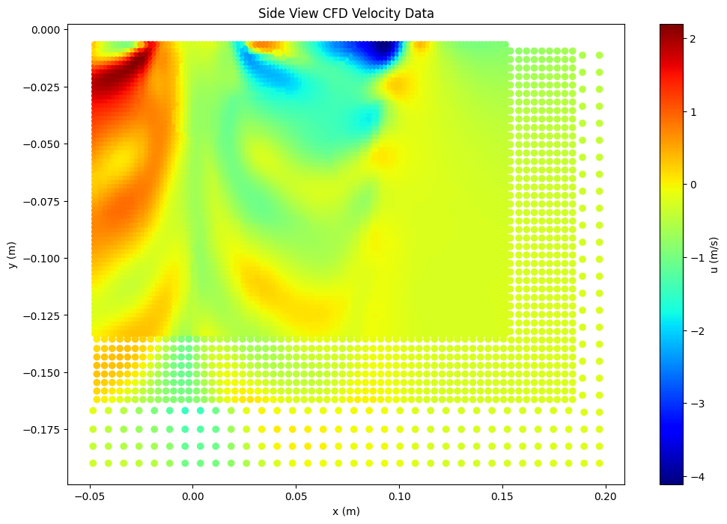
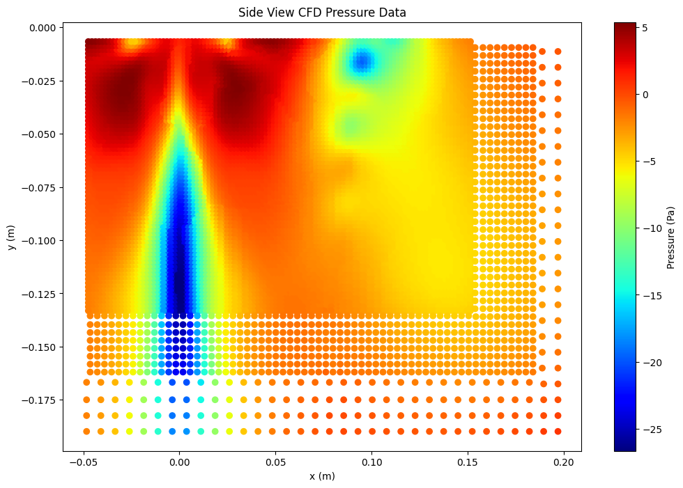
CFD Comparison data

Slide 19
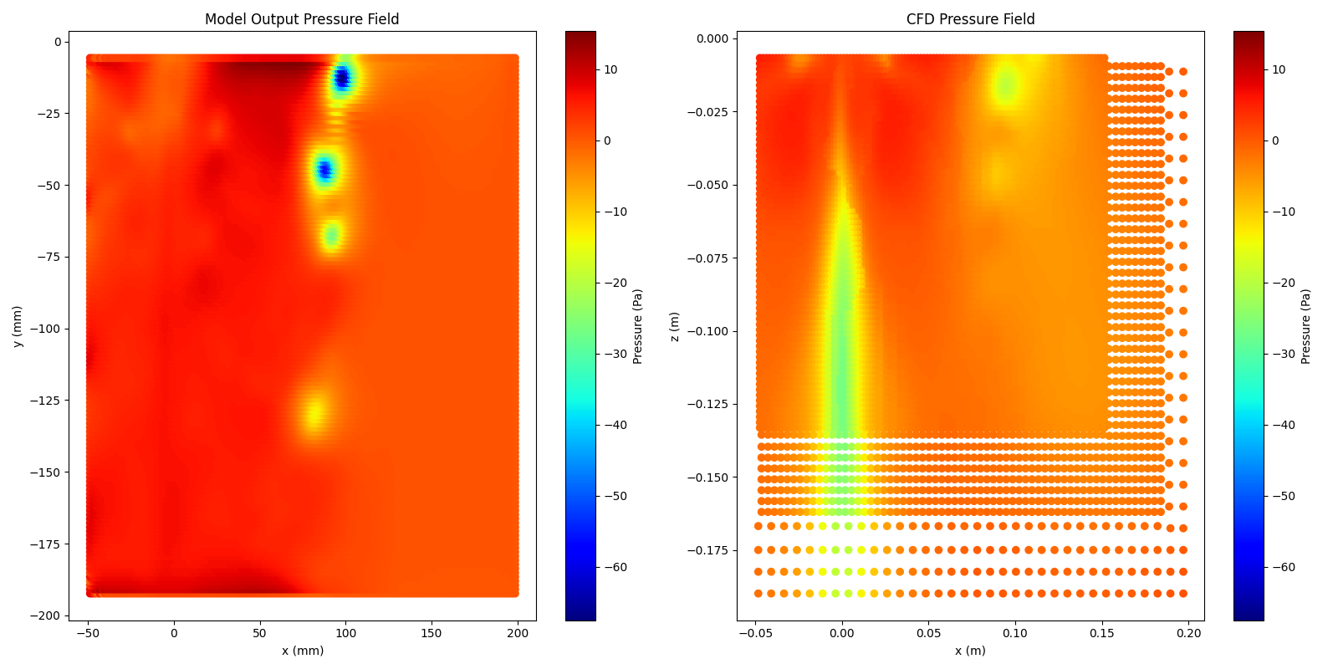
Results
5000 epochs, pressure poisson , pitot data

Slide 20
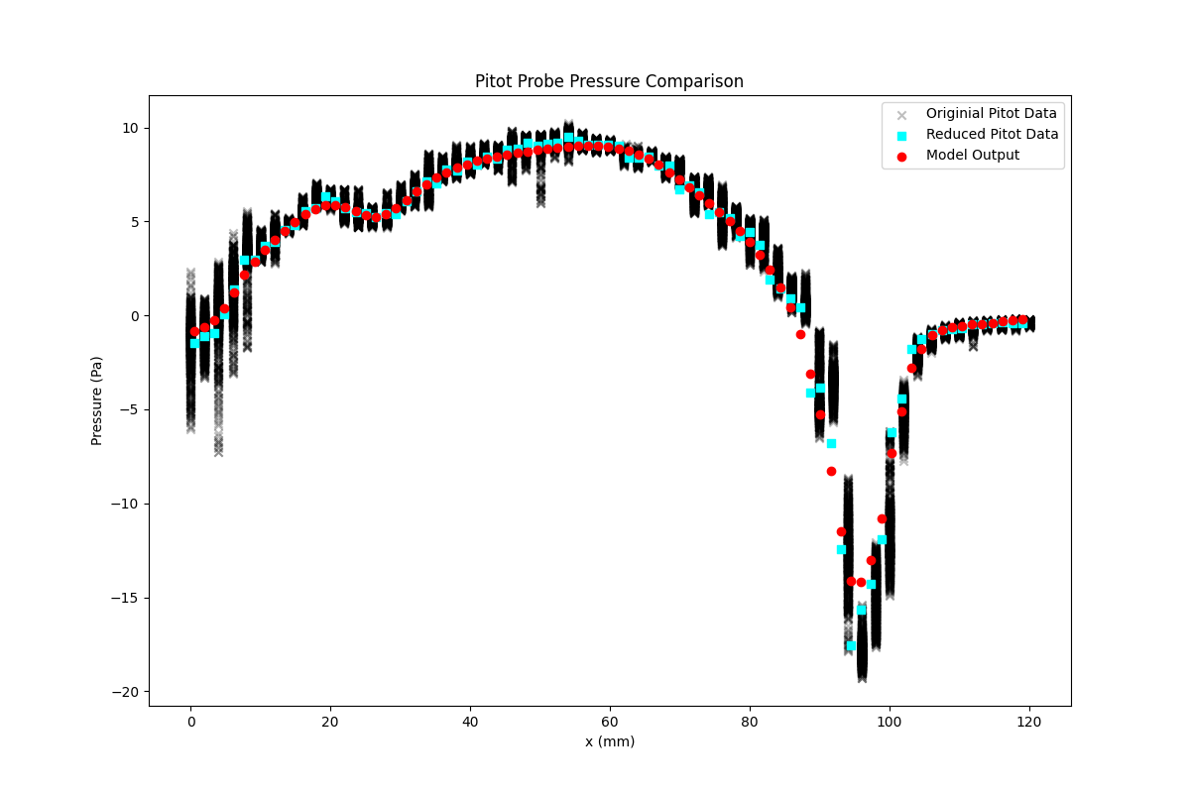
Results
5000 epochs, pressure poisson , pitot data

Slide 21
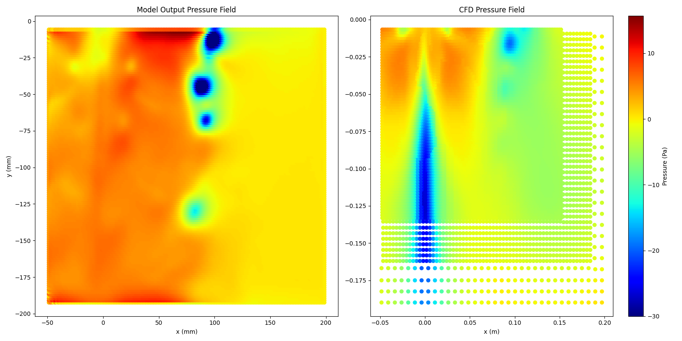
Results
Big Model: Double the number of channels for each layer

Slide 22
PIV Wake-View
Predicting: p
Code

Slide 23
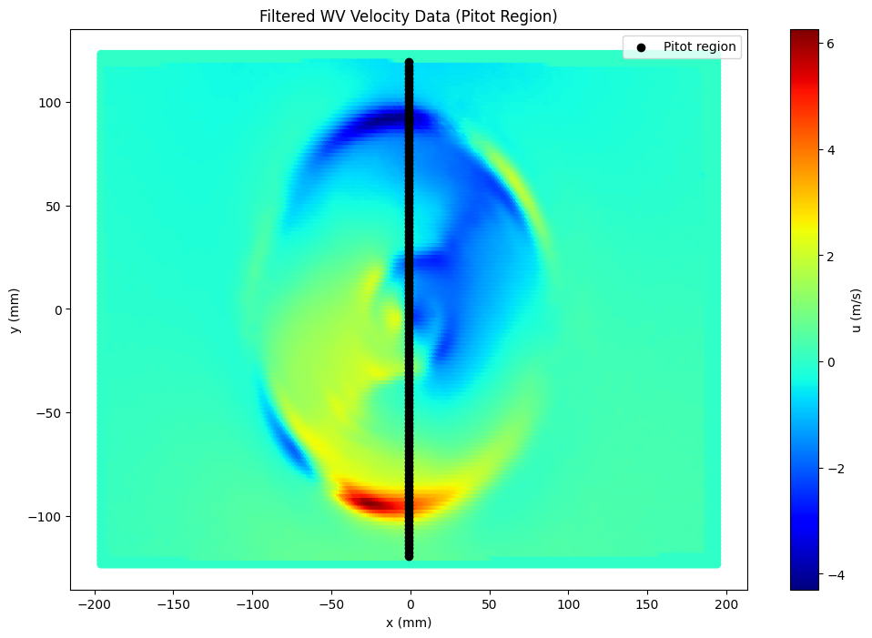
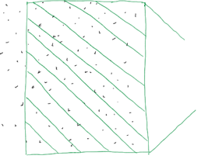
Input

Slide 24
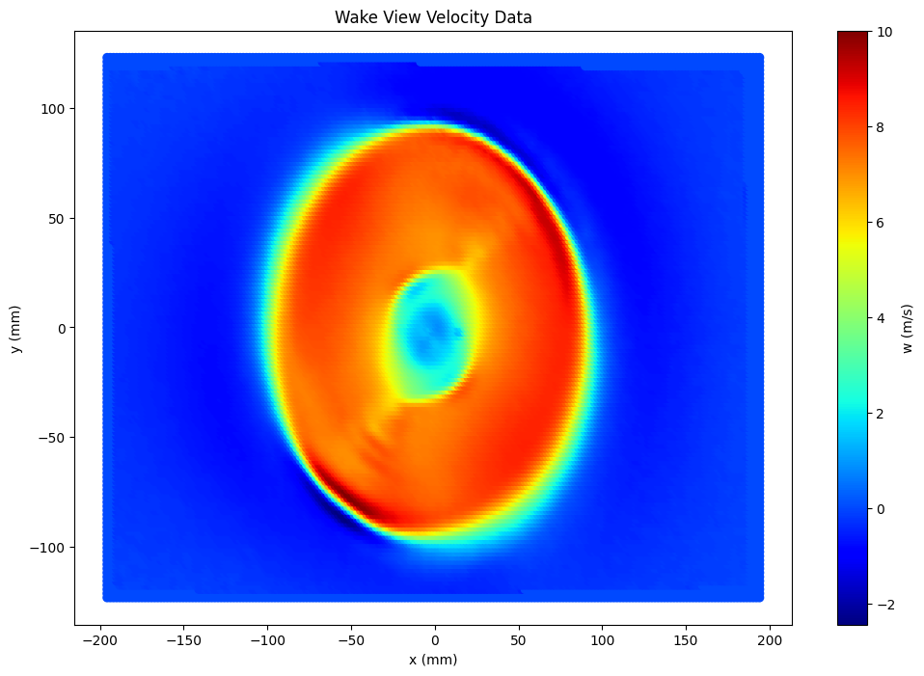
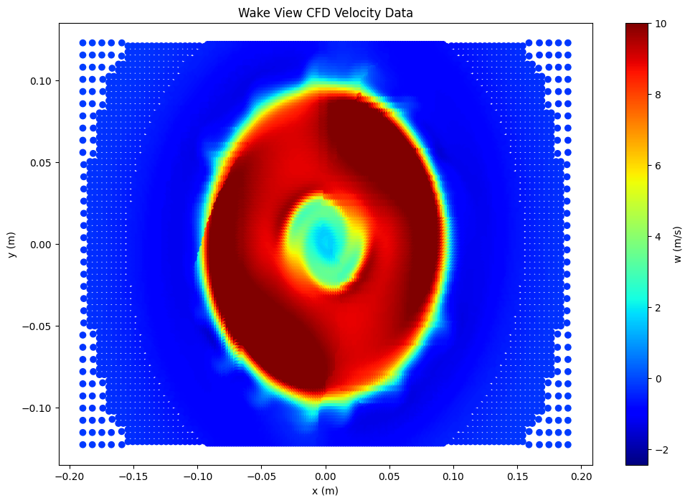
Z-Component of Velocity (w)

Slide 25
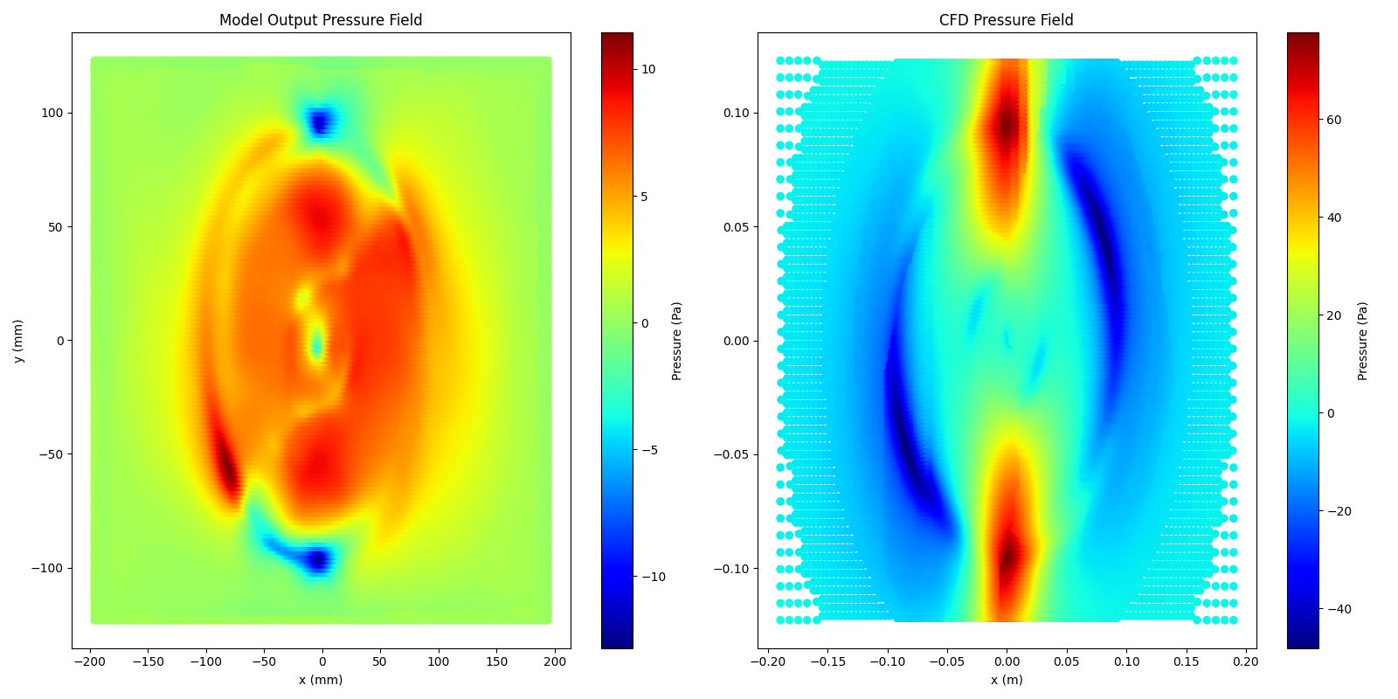
Results
5000 epochs, pressure poisson , pitot data

Slide 26
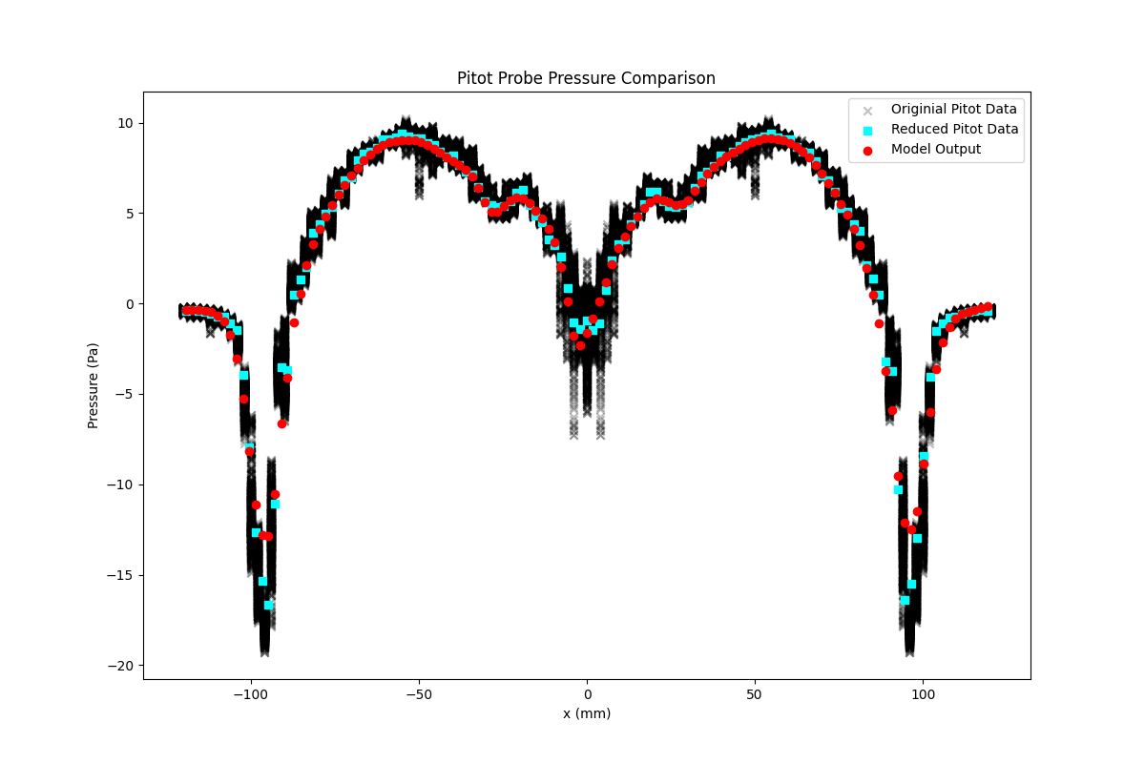
Results
5000 epochs, pressure poisson , pitot data

Slide 27
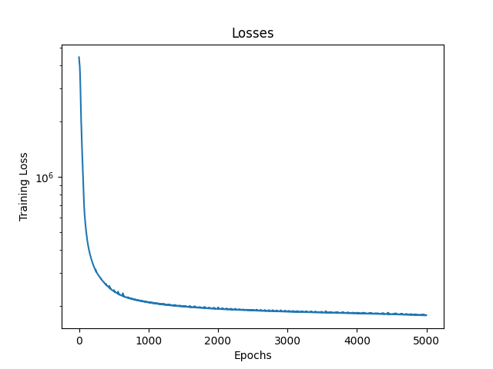
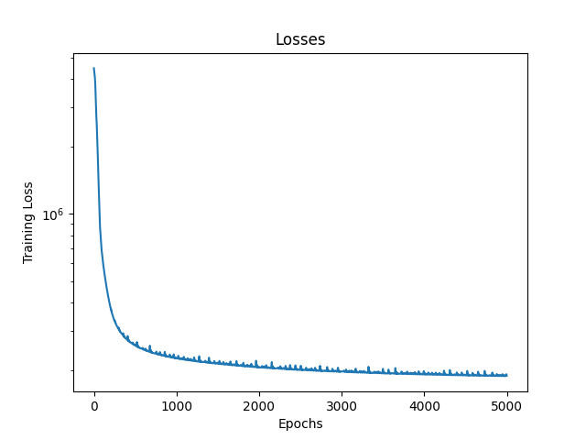
Results
5000 epochs, pressure poisson , pitot data
u, v, w
u, v

Slide 28
Conclusions
It is possible to create a semi-accurate pressure field using a physics informed convolutional neural net
Pressure requires some reference value “pitot data”
Boundary values/conditions are more influential than mid-field values
Tip vortices are captured well in the side-view predicted pressure field
The side-view predicted pressure field matches cfd in form but is off in magnitude
The wake-view predicted pressure field is assisted by the Z-component of velocity

Slide 29
Improvements/Future Work
Pitot Probe pressure data is time averaged, PIV is largely unsteady and CFD is unsteady
For the full benefit of the Z-Component of velocity two Z-planes of PIV data are necessary for derivatives in the z direction
Phase/Tip Vortex mismatch for Wake-View PIV and CFD data
Use the same process on the CFD u, v, w data to further verify the model
Rhie-Chow Interpolation: for better pressure/velocity coupling and fewer pressure oscillations

Slide 30


Acknowledgments
Dr. Andrew Ning: teacher, derivative code, other template code
Nathan Welker: PIV data, understanding
AI: Coding assistance

